Slide 1
Quick-Sort
Quick-sort is a randomized sorting algorithm based on the divide-and-conquer paradigm:
  Divide: If S has atleast two elements, pick a random element x (called pivot) and partition S into
    L elements less than x
    E elements equal to x
    G elements greater than x
  Recur: sort L and G recursively
  Conquer: join L, E and G in order.
x
x
G
L
E
x

Slide 2
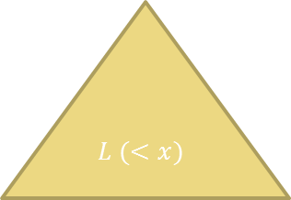
1. Split Using pivot x
E (=x)
2. Recur
2. Recur
$$L (<x)$$
G ( >x)
3. Concatenate

Slide 3
Partition
We partition an input sequence as follows:
  We remove, in turn, each element y from S and
  We insert y into L, E or G, depending on the result of the comparison with the pivot x
Each insertion and removal is at the beginning or at the end of a sequence, and hence takes O(1) time
Thus, the partition step of quick-sort takes O(n) time
Algorithm partition(S, p)
Input sequence S, position p of pivot
Output subsequences L, E, G of the
elements of S less than, equal to,
or greater than the pivot, resp.
L, E, G ← empty sequences
  x ← S.remove(p)
  while ¬S.isEmpty()
  y ← S.remove(S.first())
  if y < x
  L.insertLast(y)
  else if y = x
  E.insertLast(y)
  else { y > x }
  G.insertLast(y)
  return L, E, G

Slide 4
Quick-Sort Tree
An execution of quick-sort is depicted by a binary recursion tree
  Each node represents a recursive call of quick-sort and stores
    Unsorted sequence before the execution and its pivot
    Sorted sequence at the end of the execution
  The root is the initial call
  The leaves are calls on subsequences of size 0 or 1

Slide 5
Execution Example (cont.)
Input Sequences processed at each node of T
85 24 63 45 17 31 96 50→ 1
24 45 17 31
85 63 961
24 17
45
85 63
9 → 9
9 → 9
24
9 → 9
85

Slide 6
Execution Example (cont.)
Output sequences generated at each node of T
17 24 31 45 50 63 85 96
17 24 31 45
63 85 96
17 24
45
63 85
9 → 9
24
9 → 9
85

Slide 7
Worst-case Running Time
Height of the tree is linear in the worst case
When S has n distinct elements and is sorted already
Standard choice of the pivot is the unique minimum or maximum element
One of L and G has size n - 1, and 0 and E of size 1
So height of the tree is n-1 in the worst case.
depth | time
0 | n
1 | n − 1
… | …
n − 1 | 1
…

Slide 8
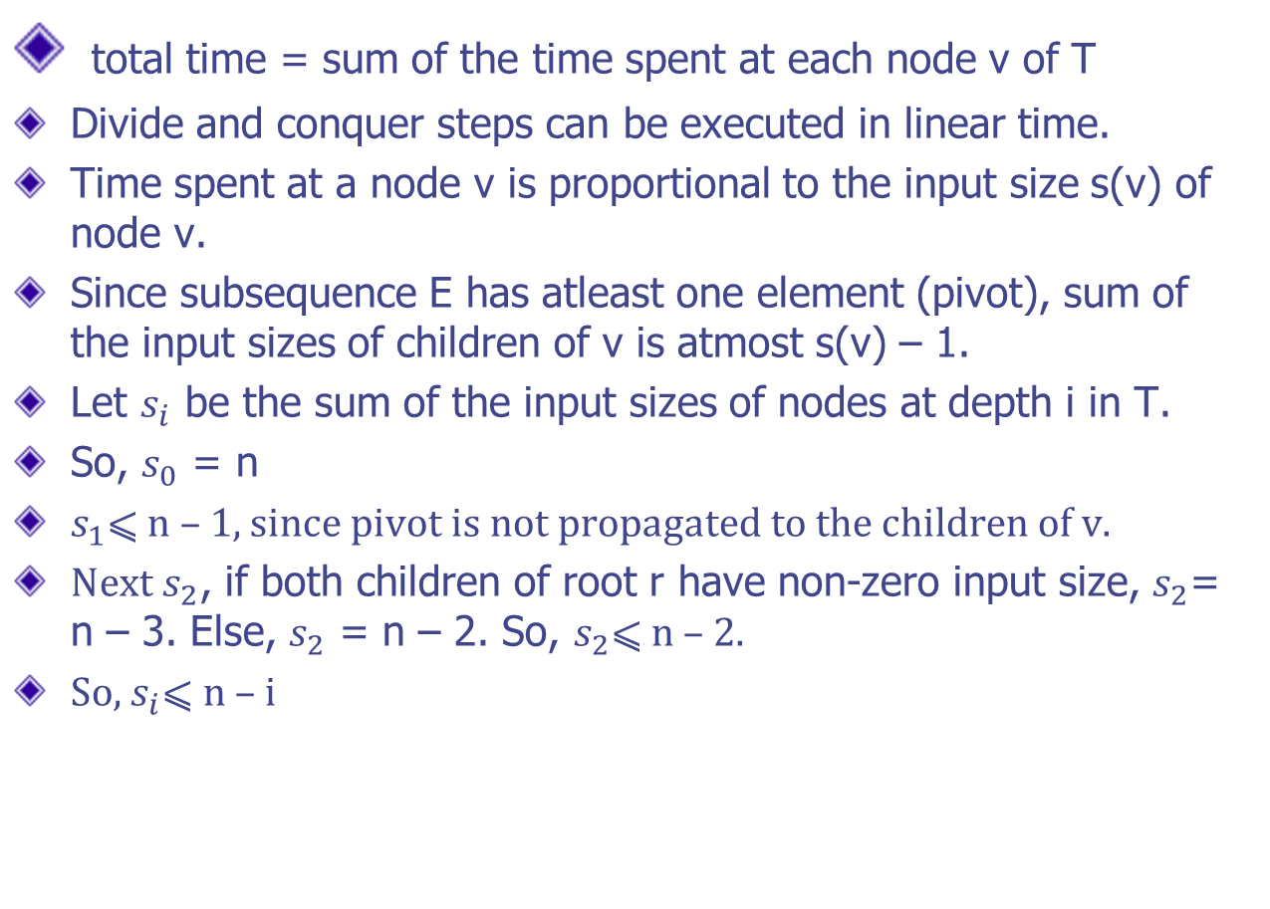
total time = sum of the time spent at each node v of T
Divide and conquer steps can be executed in linear time.
Time spent at a node v is proportional to the input size s(v) of node v.
Since subsequence E has atleast one element (pivot), sum of the input sizes of children of v is atmost s(v) – 1.
Let $s_{i}$ be the sum of the input sizes of nodes at depth i in T.
So, $s_{0}$ = n
$s_{1}$⩽ n – 1, since pivot is not propagated to the children of v.
Next $s_{2}$, if both children of root r have non-zero input size, $s_{2}$= n – 3. Else, $s_{2}$ = n – 2. So, $s_{2}$⩽ n – 2.
So, $s_{i}$⩽ n – i

Slide 9

As height of the tree T is n-1 in the worst case, running time in worst case is
$O\left(\sum_{i=0}^{n−1}{s_{i}}\right)$ = $O\left(\sum_{i=0}^{n−1}{n−i}\right)$ = $O\left(\sum_{i=1}^{n}{i}\right)$ = $O\left(n^{2}\right)$

Slide 10
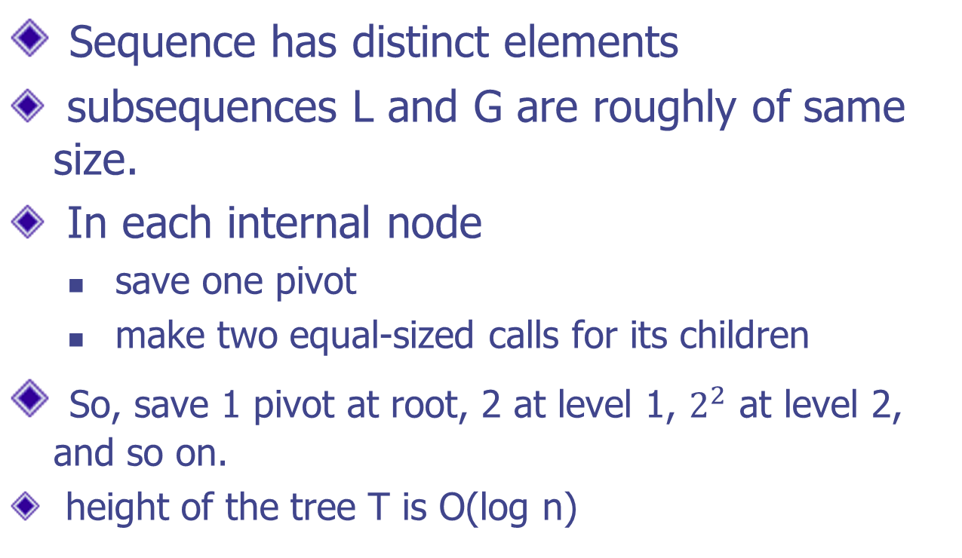
Best Case Analysis
Sequence has distinct elements
subsequences L and G are roughly of same size.
In each internal node
  save one pivot
  make two equal-sized calls for its children
So, save 1 pivot at root, 2 at level 1, $2^{2}$ at level 2, and so on.
height of the tree T is O(log n)

Slide 11
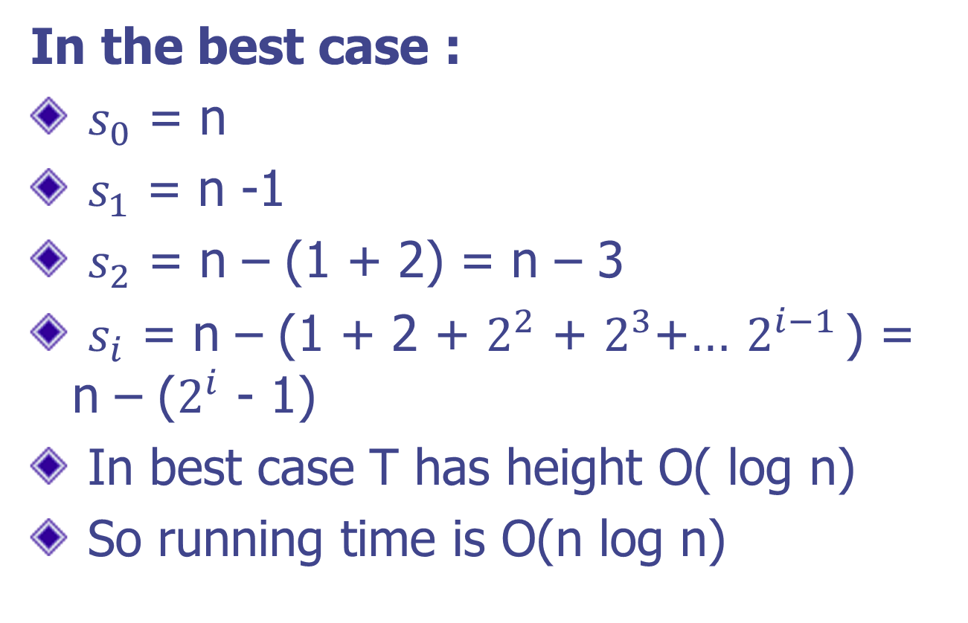
In the best case :
$s_{0}$ = n
$s_{1}$ = n -1
$s_{2}$ = n – (1 + 2) = n – 3
$s_{i}$ = n – (1 + 2 + $2^{2}$ + $2^{3}$+… $2^{i−1 }$) = n – ($2^{i}$ - 1)
In best case T has height O( log n)
So running time is O(n log n)

Slide 12
Randomized quick sort
We expect the average running time of quick sort to be similar to the best case running time , O( n log n).
introducing randomization makes quick-sort behave exactly.
the partition step divides S almost equally.
pivot is a random element of the input sequence.

Slide 13
In-Place Quick-Sort
Quick-sort can be implemented to run
in-place
In the partition step, we divide into two
non-empty parts (less than or equal to pivot and greater than or equal to pivot).
Recursively divide each part into two smaller parts, etc.

Slide 14
In-Place Partitioning
Perform the partition using indices lo & hi to split S into two non-empty subsets ≤ pivot and ≥ pivot.
Repeat until lo and hi cross:
  Scan lo to the right until find an element ≥ x.
  Scan hi to the left until find an element ≤ x.
  Swap elements at indices lo and hi
lo
hi
3 2 5 1 0 7 3 5 6 2 7 4 8 9 7 8 9
(pivot = 6)
lo
hi
3 2 5 1 0 7 3 5 6 2 7 4 8 9 7 8 9

Slide 15
Java Code – Pivot middle element
static void qSort( int a[], int lo0, int hi0 ) {
int lo = lo0;
int hi = hi0;
int mid = ( lo + hi ) / 2 ;
int pivot = a[mid];
// partition array in-place into low and high parts
while( lo <= hi ) {
while(( lo < hi0 )&&( a[lo] < pivot )) {
lo++;
}
while(( hi > lo0 )&&( a[hi] > pivot )) {
hi--;
}
if( lo <= hi ) {
swap( a, lo, hi );
lo++;
hi --;
}
}
// sort the left and right parts recursively
if( hi > lo0 ) {
qSort( a, lo0, hi );
}
if( lo < hi0 ) {
qSort( a, lo, hi0 );
}
}

